Slide 1
Java loves Kotlin ❤️
Nov 2023
Alexandru Lungu, Full-Stack developer

Slide 2
E.On Development Guild
Java loves Kotlin ❤️
Introduction & Setup
Kotlin 101
Bonus: Arrow KT (functional programming)

Slide 3

E.On Development Guild
Kotlin
Kotlin adopted features from other languages:
- from Java: 100% interoperable with Java ( call java->kotlin or kotlin->java )
- from Python: key value function arguments, default arguments
- from Java-script: Optional with ?, DSL, WebAssembly
- from Scala: functional style
- from GO Lang: coroutines
- from C++: copy constructor
Advantages:
- removes code boilerplate=> happy productive developer 😀
- clean code and immutable data=> less bugs => happy client 😀
- great for BE or mobile (primary language for Android)
- multiplatform, can generate FE(JS) code/ WebAssembly ready
- structured concurrency

Slide 4
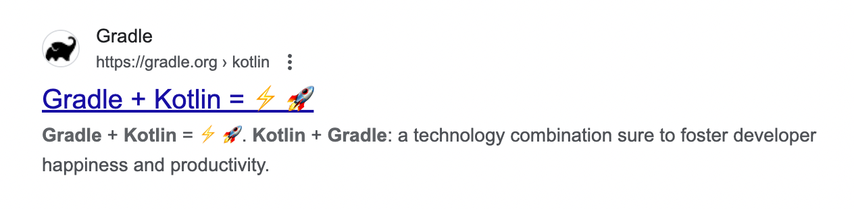
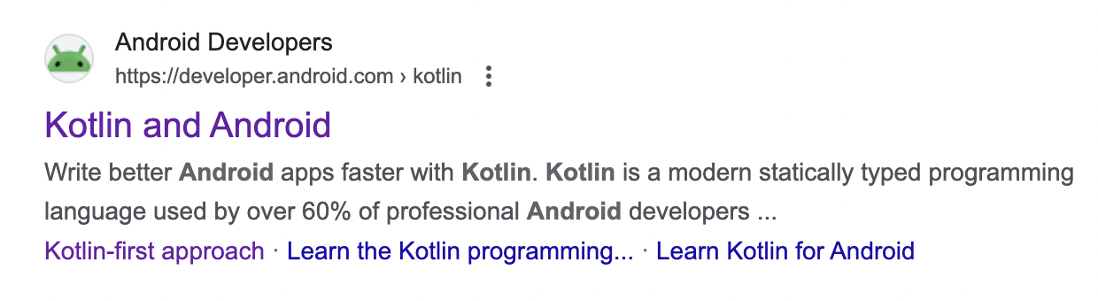
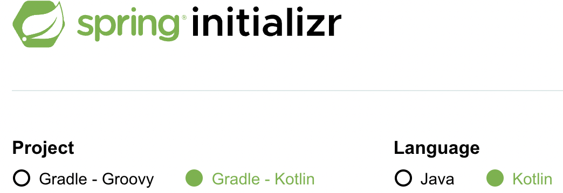
E.On Development Guild
Expressive and concise: You can do more with less. Express your ideas and reduce the amount of boilerplate code. 67% of professional developers who use Kotlin say Kotlin has increased their productivity.
Safer code: Kotlin has many language features to help you avoid common programming mistakes such as null pointer exceptions. Android apps that contain Kotlin code are 20% less likely to crash.
Interoperable: Call Java-based code from Kotlin, or call Kotlin from Java-based code. Kotlin is 100% interoperable with the Java programming language, so you can have as little or as much of Kotlin in your project as you want.
Structured Concurrency: Kotlin coroutines make asynchronous code as easy to work with as blocking code. Coroutines dramatically simplify background task management for everything from network calls to accessing local data.

Slide 5

E.On Development Guild
dds
Monolith class dependency (in time)

Slide 6

E.On Development Guild

Slide 7
E.On Development Guild
Modular monolith with:
- Vertical slices and ArchUnit: Unit test your Java architecture
- Gradle modules feature
- Springboot modulith: https://spring.io/blog/2022/10/21/introducing-spring-modulith

Slide 8
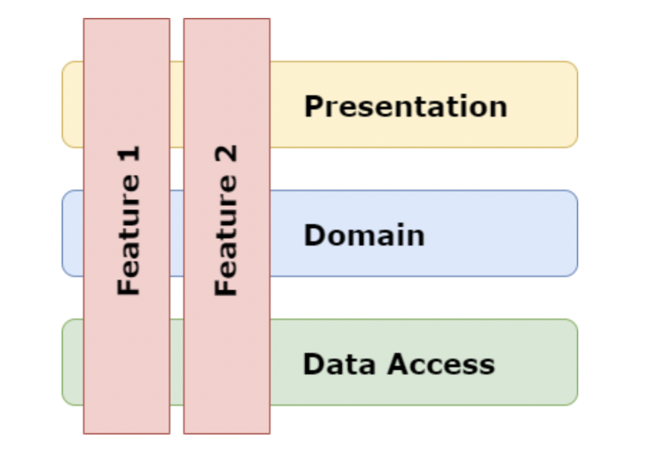
E.On Development Guild
Introduction & Setup
Problem: Big ball of mud
Solution: Vertical slice Architecture= isolate different features. Can transform a monolith into a modular monolith. In future, those vertical slices can be extracted into a microservice
Adopt Kotlin:
- keep old Java code
- create new vertical slices(features) in kotlin. E.g Feature 1= java, Feature2=kotlin

Slide 9
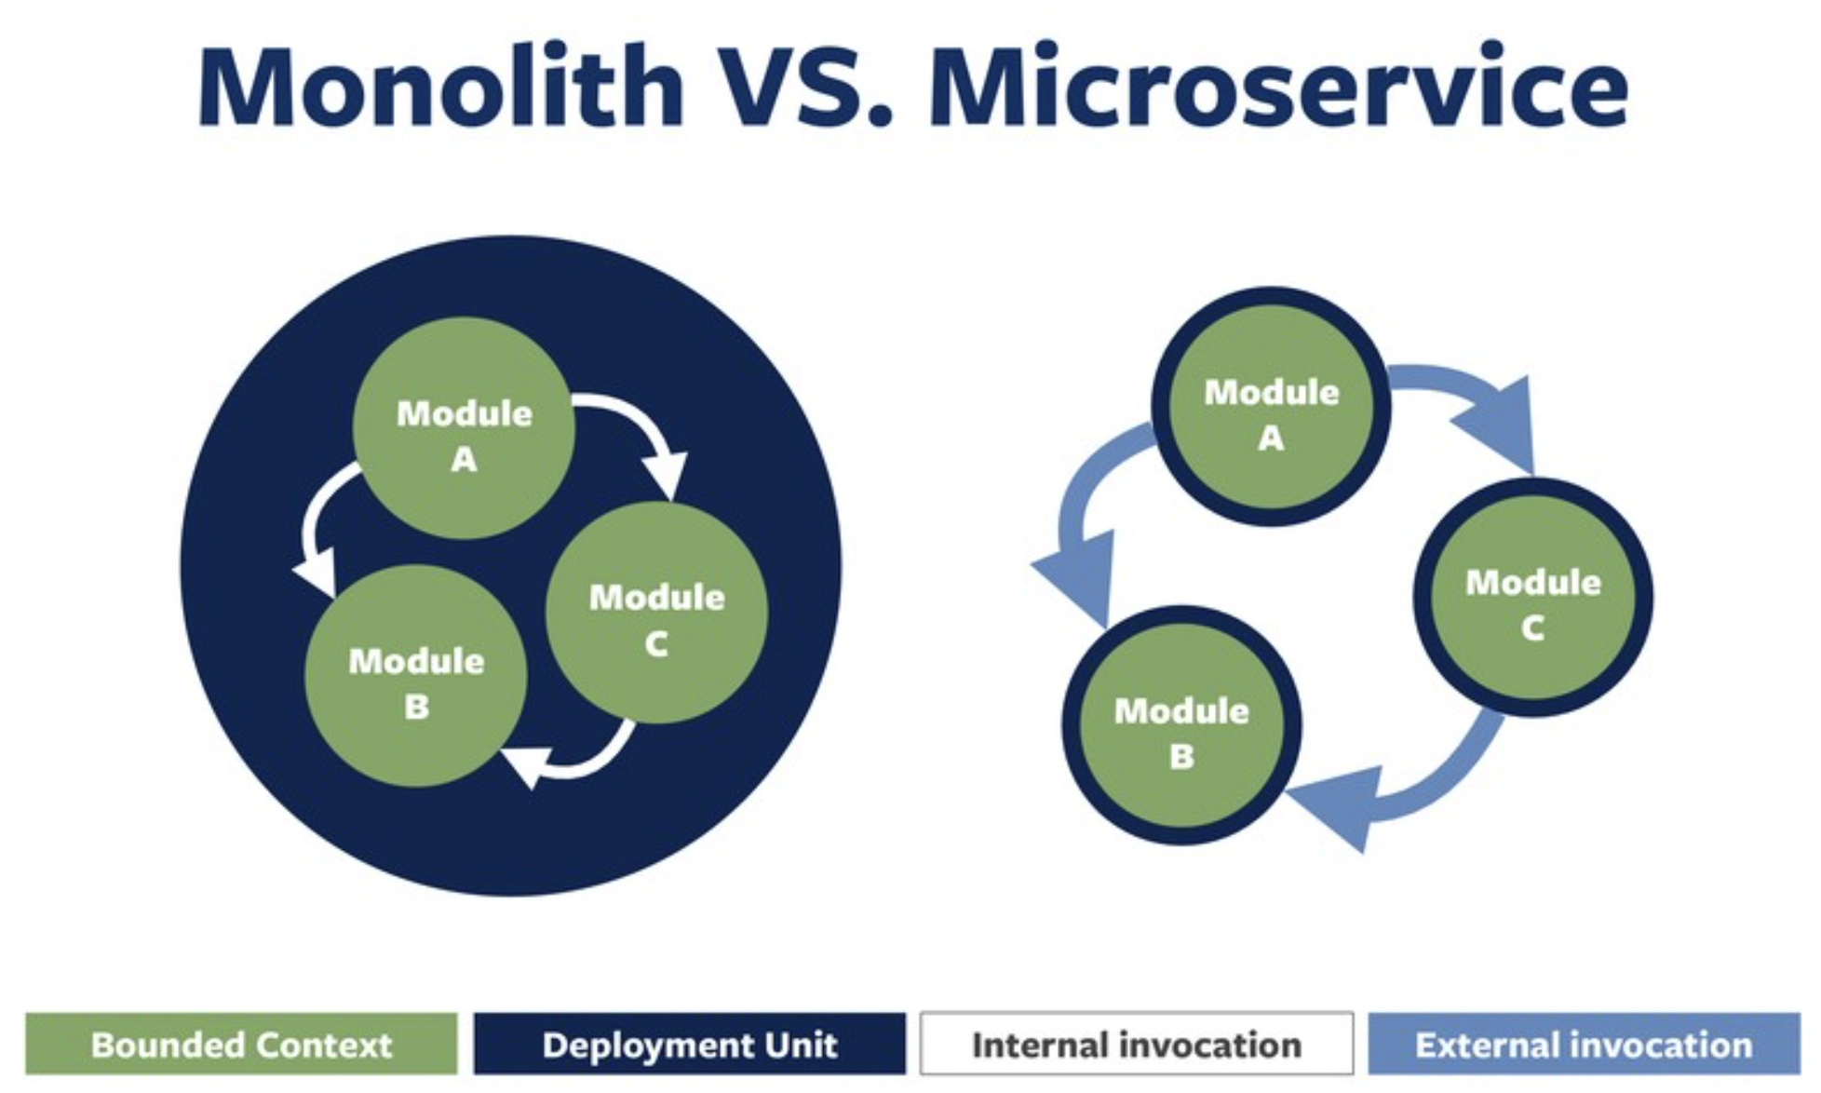
E.On Development Guild

Slide 10
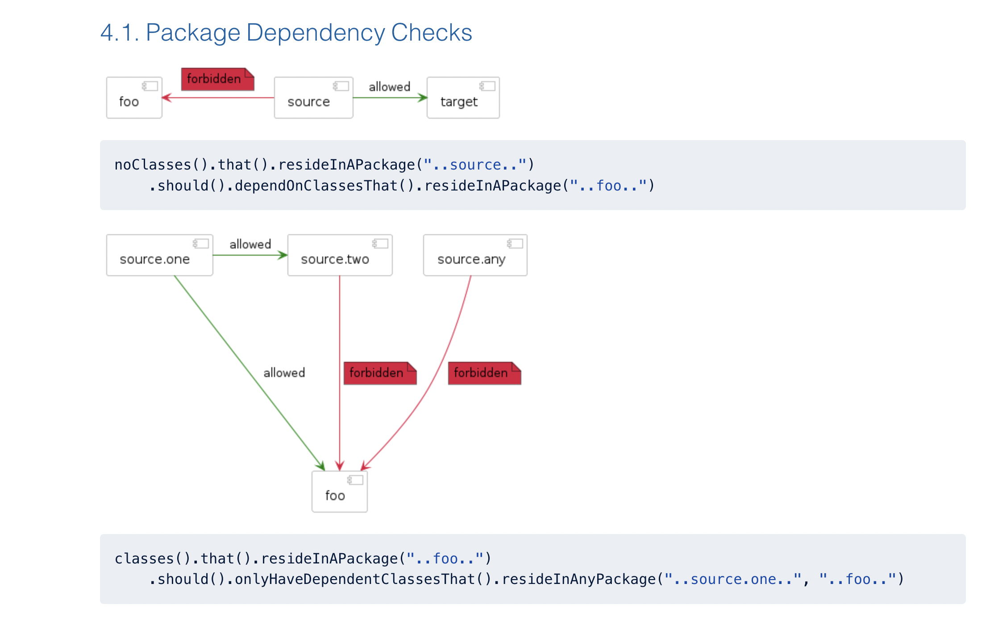
Vertical slices and ArchUnit: Unit test your Java architecture
E.g Feature 1= java, Feature2=kotlin

Slide 11

E.On Development Guild

Slide 12
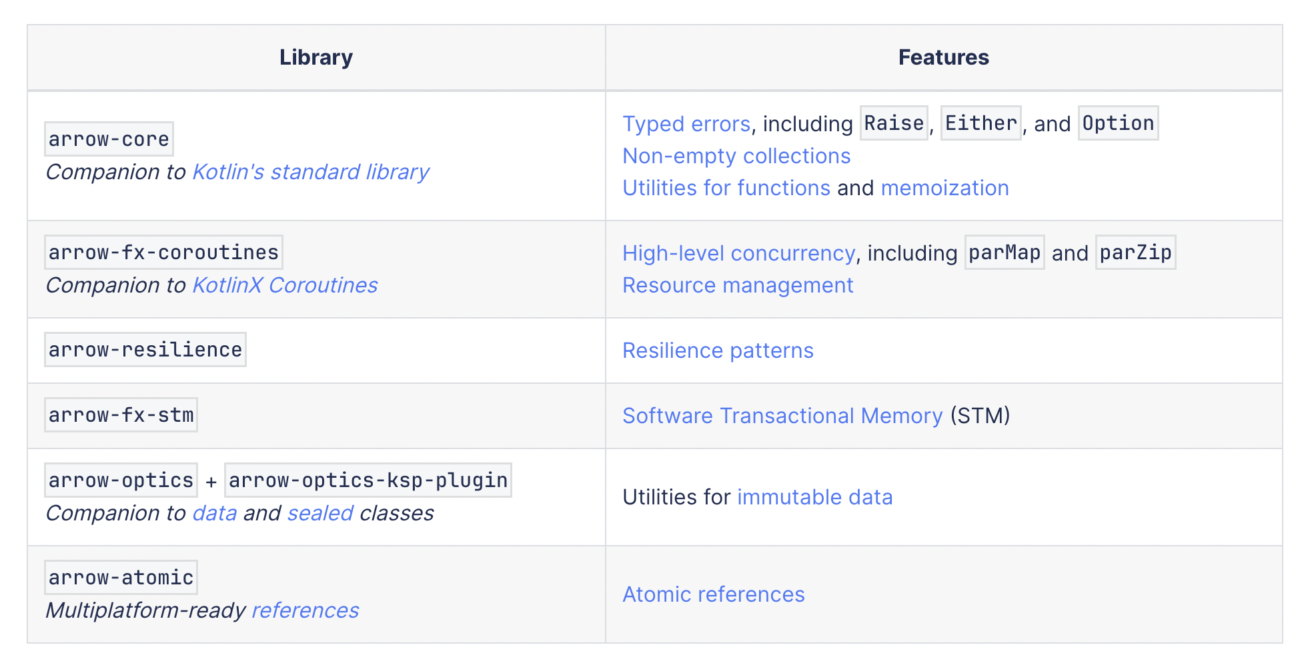
E.On Development Guild
3. Bonus time: Arrow KT (Functional programming in Kotlin)
https://arrow-kt.io/learn/overview/

Slide 13
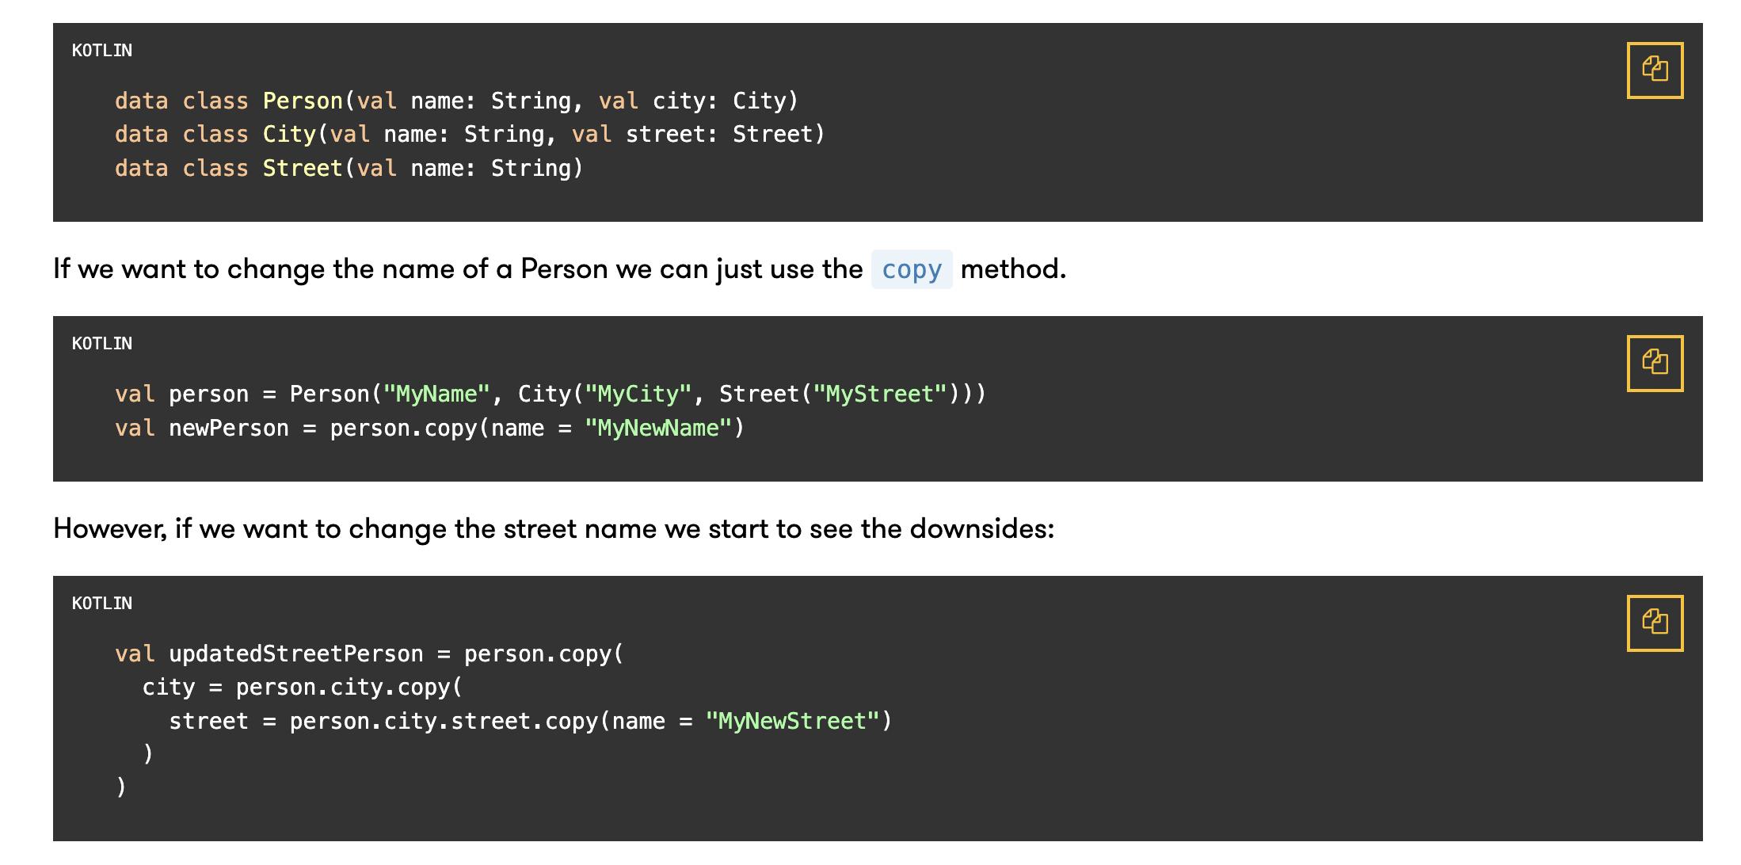
E.On Development Guild
-> Optics in Arrow KT- modify data structures in an immutable way

Slide 14
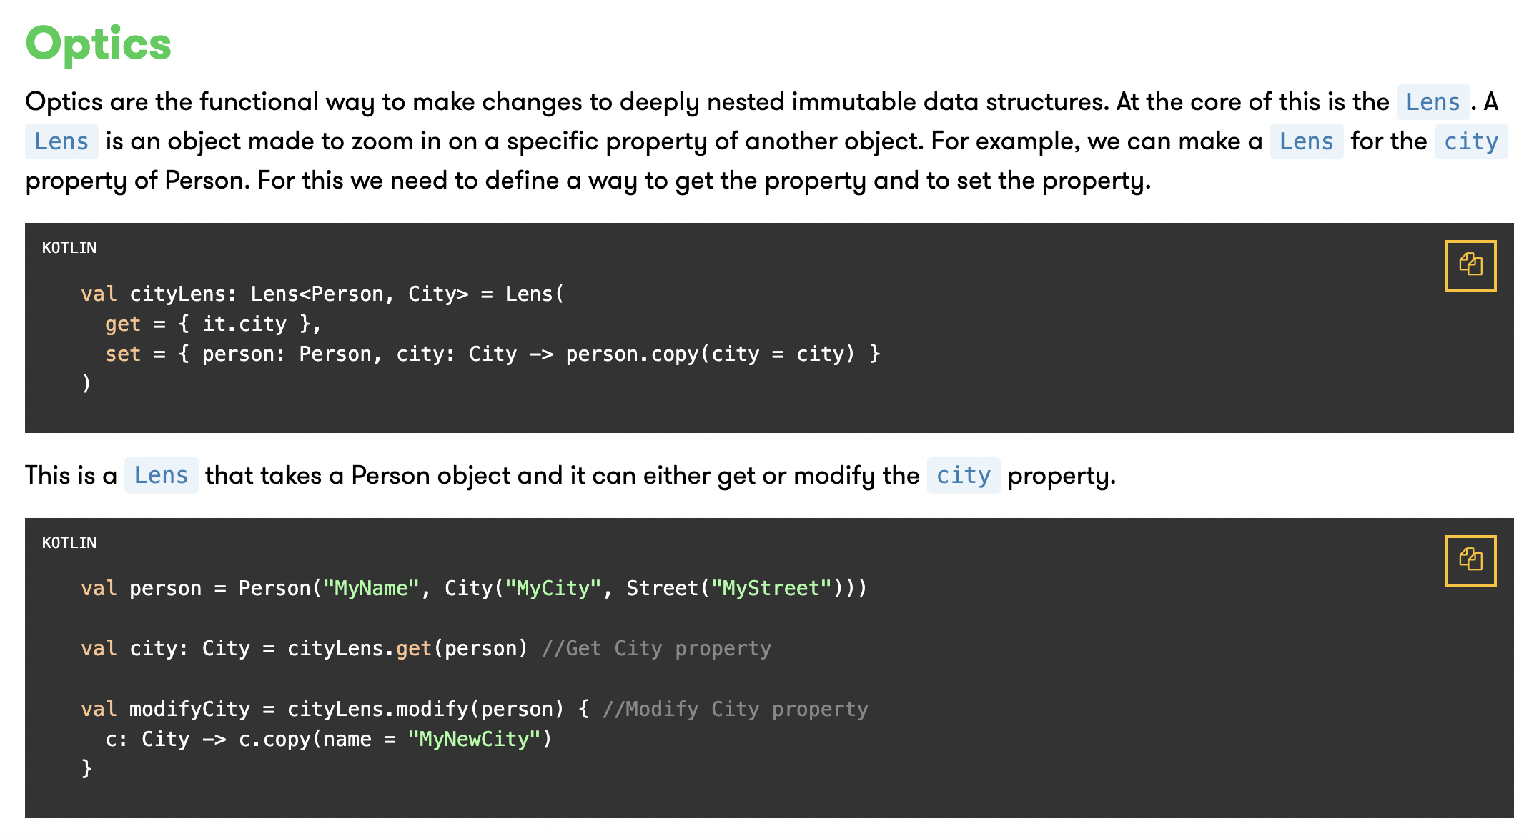
E.On Development Guild

Slide 15
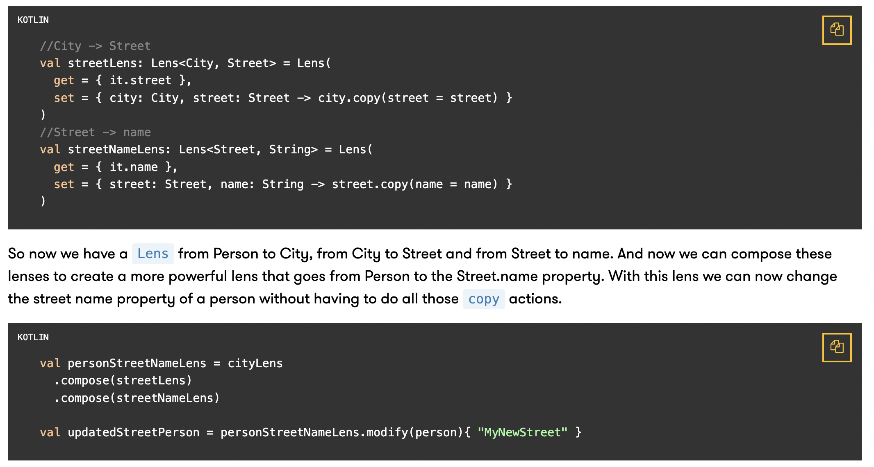
E.On Development Guild

Slide 16
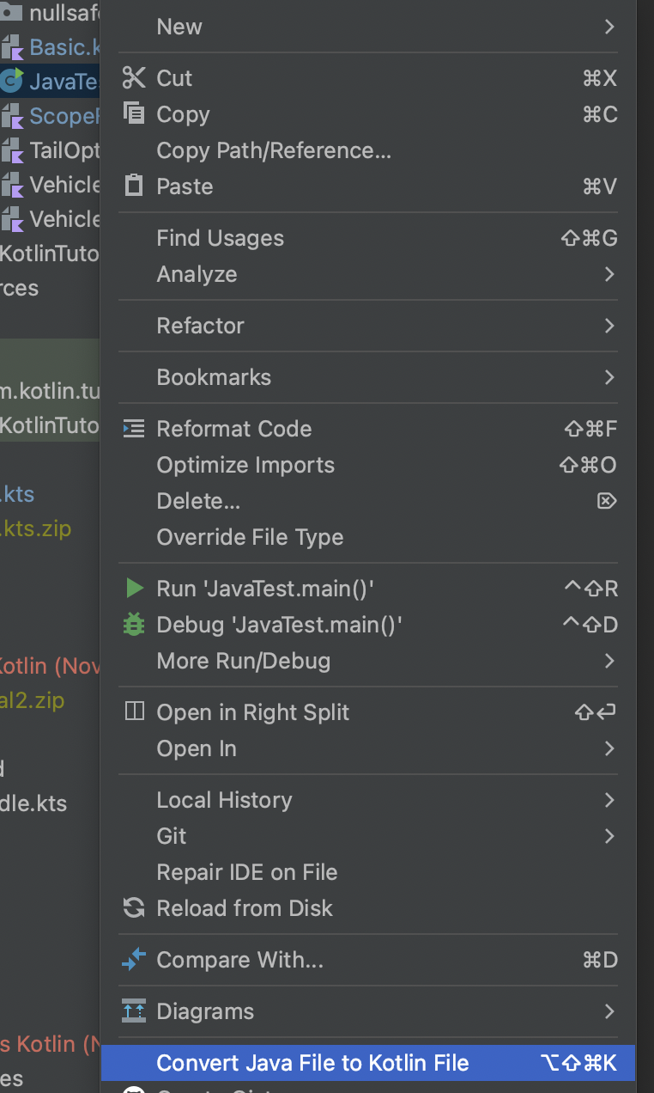
E.On Development Guild
How to migrate code:
Intellij convert a Java file to kotlin

Slide 17
E.On Development Guild

Slide 18
Questions?
Comments?
Feedback?

Slide 19
Thank you!

